Slide 1
Artificial Intelligence forward and backward chaining

Slide 2
Contents
Unification
Generalized Modus Ponens
Forward Chaining
Backward

Slide 3
Unification
Unification: The process of finding all legal substitutions that make logical expressions look identical
It is a recursive algorithm

Slide 4
Unification
We can get the inference immediately if we can find a substitution θ such that King(x) and Greedy(x) match King(John) and Greedy(y)
θ = {x/John, y/John} works
Unify(α,β) = θ if α θ = β θ

Slide 5
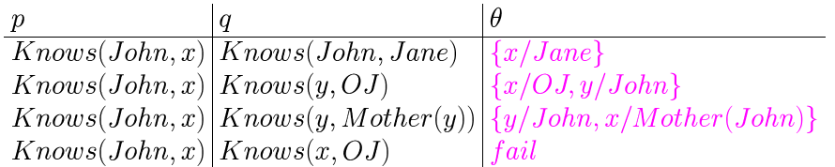
Unification

Slide 6

Generalized Modus Ponens
This is a general inference rule for FOL that does not require instantiation
Given:
  p1’, p2’ … pn’ (p1 ∧ … pn) ⇒ q
  Subst(θ, pi’) = subst(θ, pi) for all p
Conclude:
  Subst(θ, q)

Slide 7
GMP Example
∀x, Parent(x,y) ∧ Parent(y,z) ⇒ GrandParent(x,z)
Parent(James, John), Parent(James, Richard), Parent(Harry, James)
We can derive:
  GrandParent(Harry, John), bindings:
  ((x Harry) (y James) (z John)
  GrandParent(Harry, Richard), bindings:
  ((x Harry) (y James) (z Richard)

Slide 8
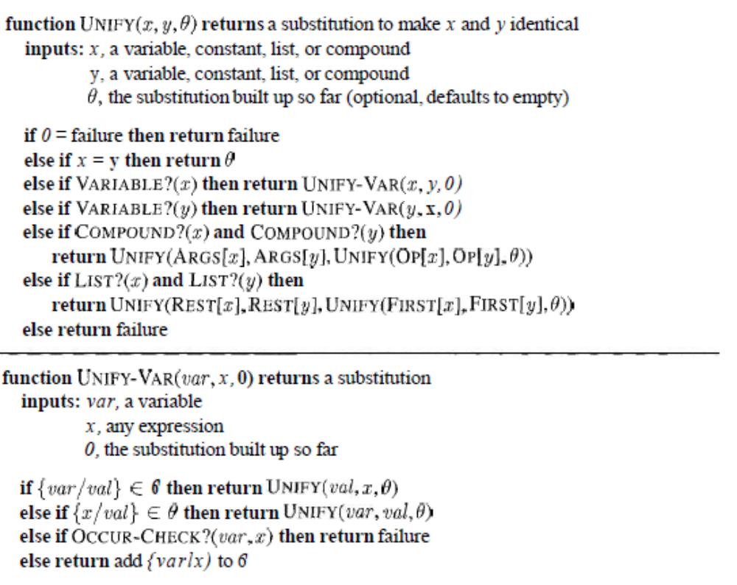


Slide 9
Forward Chaining
Forward Chaining
  Start with atomic sentences in the KB and apply Modus Ponens in the forward direction, adding new atomic sentences, until no further inferences can be made.

Slide 10
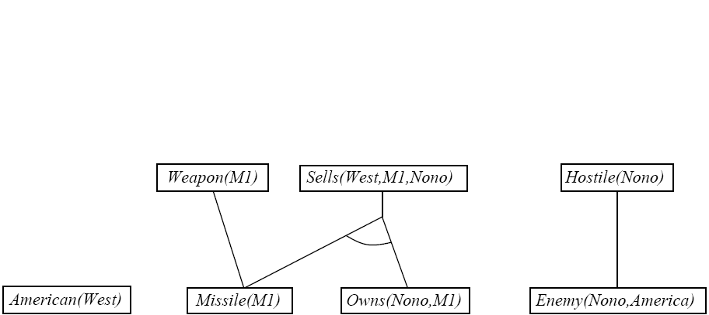
FC: Example Knowledge Base

Slide 11
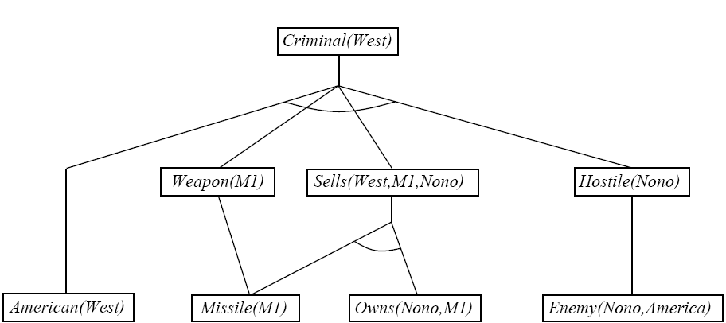
FC: Example Knowledge Base

Slide 12
Efficient Forward Chaining
Order conjuncts appropriately
  E.g. most constrained variable
Don’t generate redundant facts; each new fact should depend on at least one newly generated fact.
  Production systems
  RETE matching
  CLIPS

Slide 13
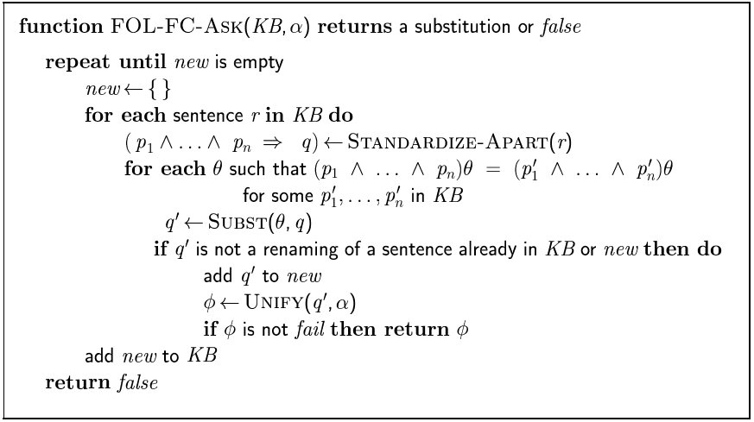
Forward Chaining Algorithm

Slide 14
Backward Chaining
Consider the item to be proven a goal
Find a rule whose head is the goal (and bindings)
Apply bindings to the body, and prove these (subgoals) in turn
If you prove all the subgoals, increasing the binding set as you go, you will prove the item.
Logic Programming

Slide 15
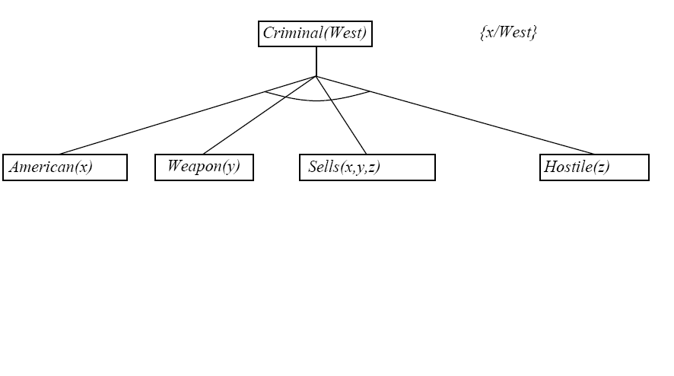
Backward Chaining Example

Slide 16
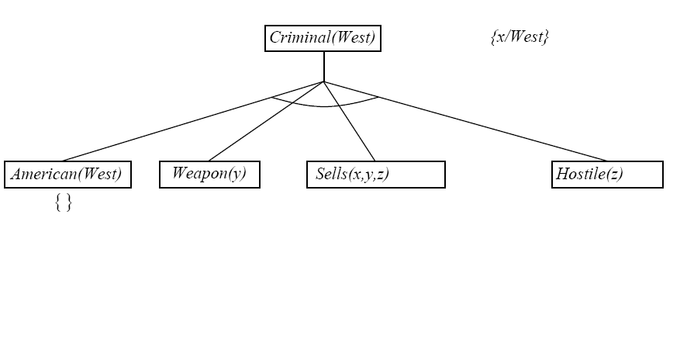
Backward Chaining Example

Slide 17
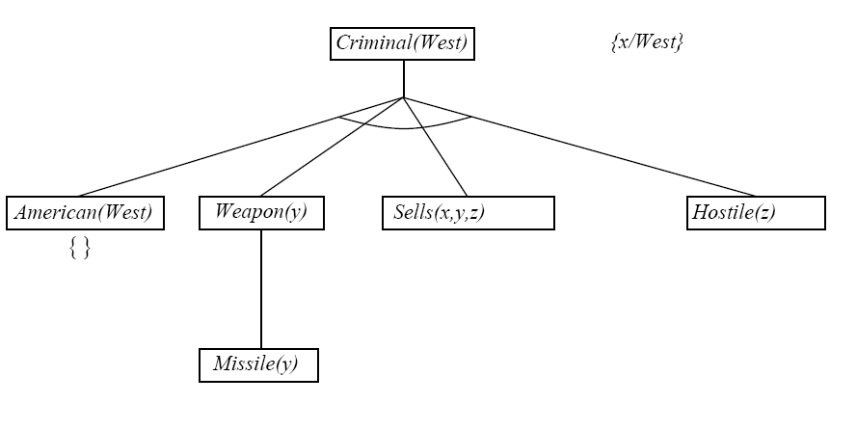
Backward Chaining Example

Slide 18
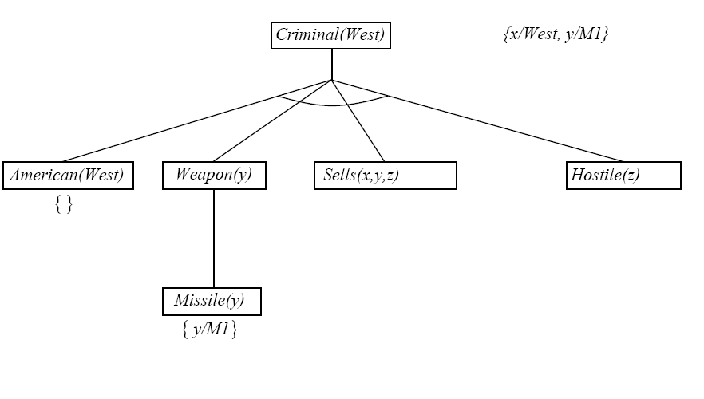
Backward Chaining Example

Slide 19
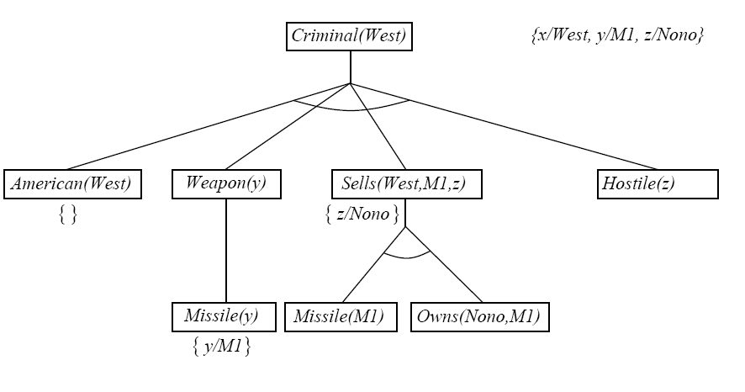
Backward Chaining Example

Slide 20
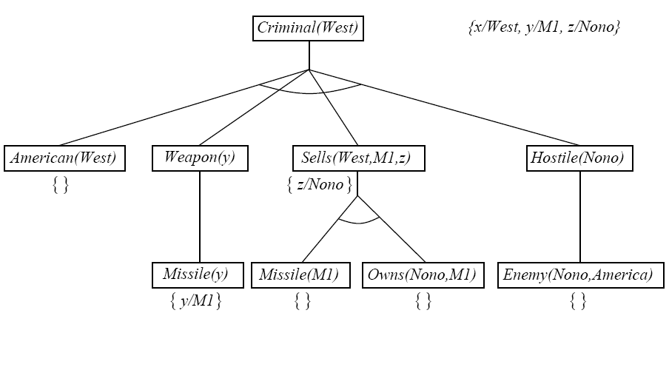
Backward Chaining Example

Slide 21
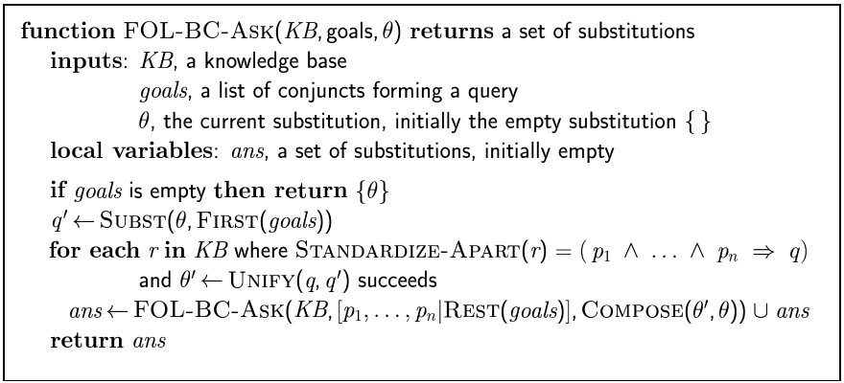
Backward Chaining Algorithm

Slide 22
Properties of Backward Chaining
Depth-first recursive proof search: space is linear in size of proof
Incomplete due to infinite loops
  Fix by checking current goal with every subgoal on the stack
Inefficient due to repeated subgoals (both success and failure)
  Fix using caching of previous results (extra space)
Widely used without improvements for logic programming

Slide 23
Inference Methods
Unification (prerequisite)
Forward Chaining
  Production Systems
  RETE Method (OPS)
Backward Chaining
  Logic Programming (Prolog)
Resolution
  Transform to CNF
  Generalization of Prop. Logic resolution

